Slide 1
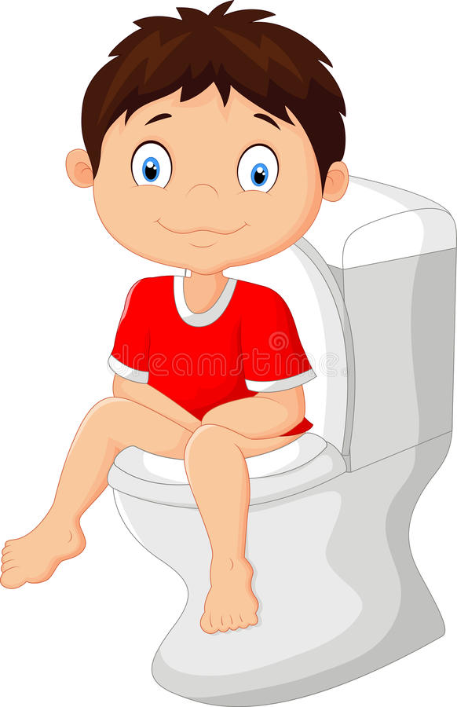
Using the Bathroom
1

Slide 2
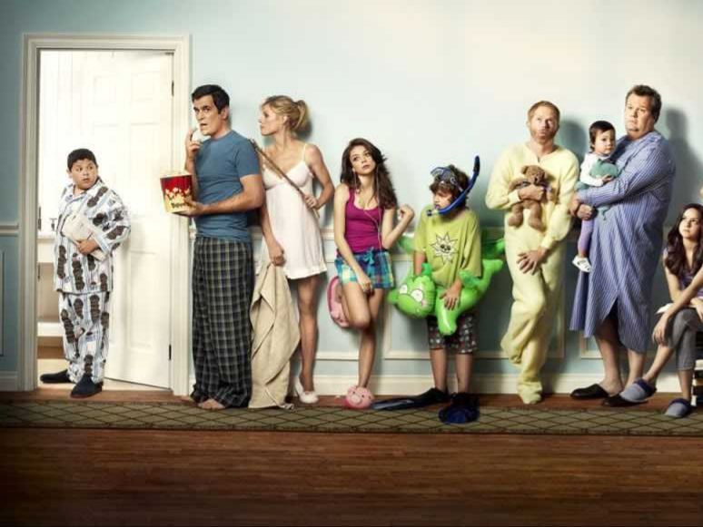
2
Everyone uses the toilet and I can too!

Slide 3
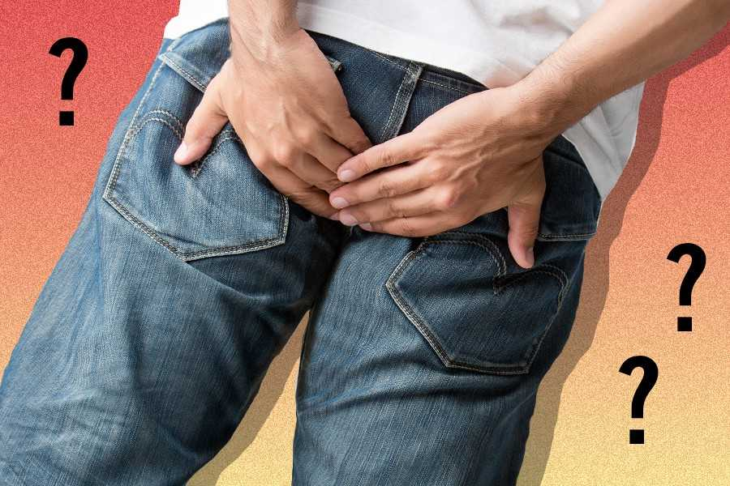
3
I do not like the way it feels when I use the bathroom in my underwear. It feels very uncomfortable.

Slide 4
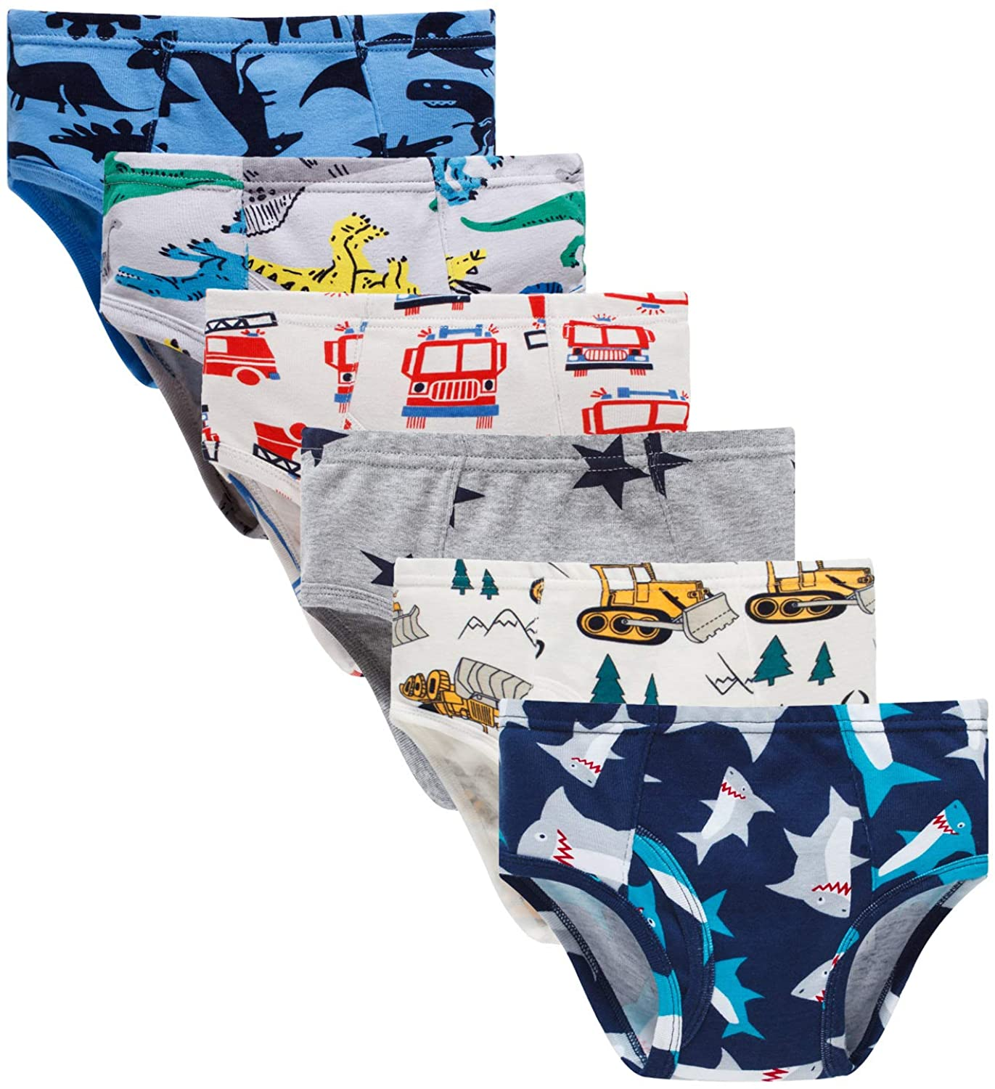
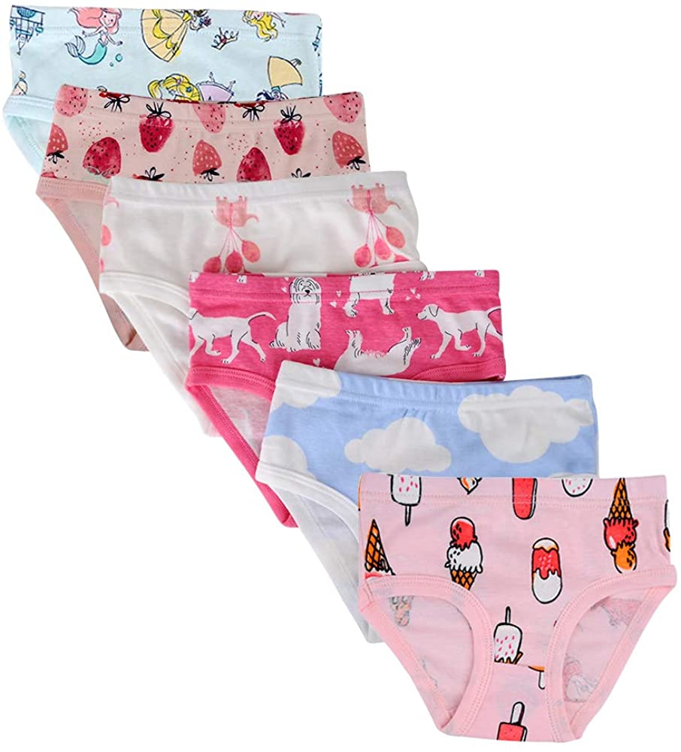
4
5
I am excited to wear my big kid underwear instead of a pull up!

Slide 5
6
I will know when it’s time to go to the toilet when I feel pressure in my stomach.

Slide 6
The pressure may make my legs feel wiggly or bouncy. My legs might squeeze together or start to dance.

Slide 7
First Then
7
I should use the bathroom multiple times a day. I can use the bathroom when I wake up.

Slide 8
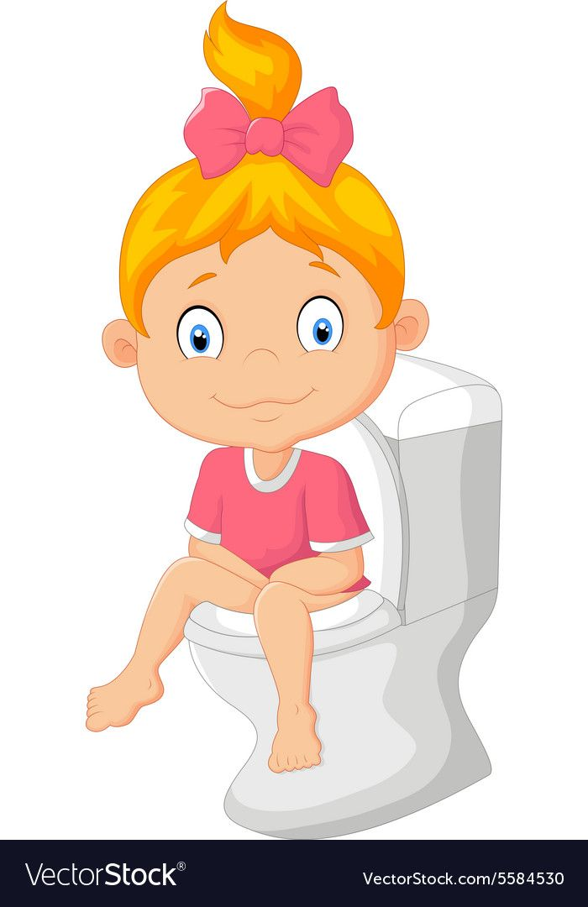
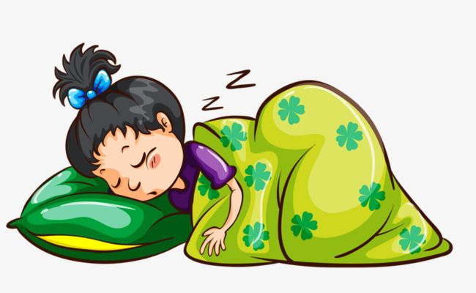
First Then
8
9
I can use the bathroom before
I go to sleep.

Slide 9
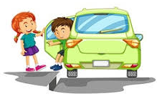
First Then
10
I can use the before I get in the car.

Slide 10
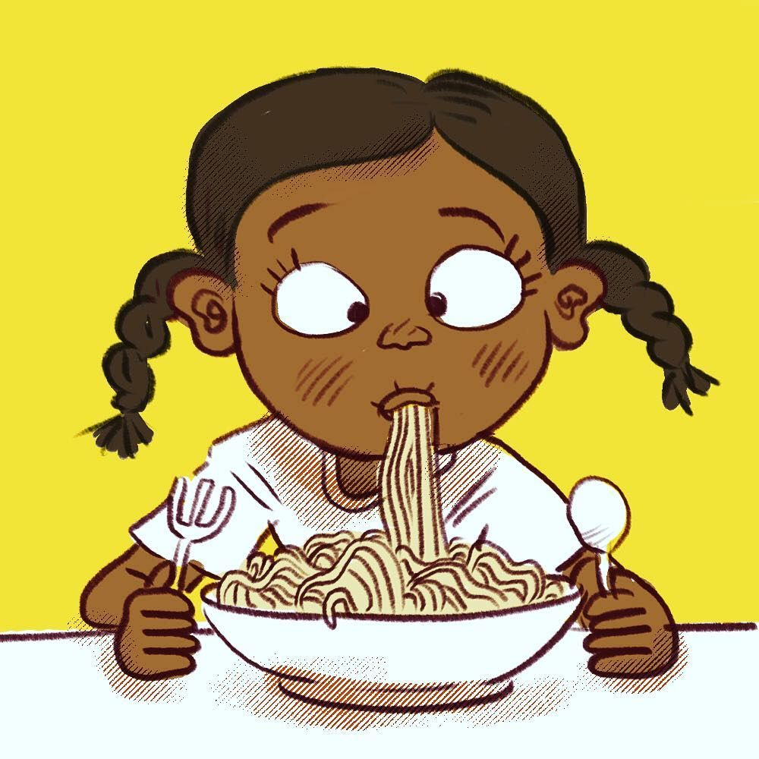
First Then
11
I can use the bathroom when I am all done eating.

Slide 11
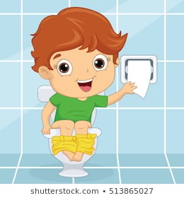
5
4
3
2
1
All done!
12
I will sit on the toilet, pull down my pants, and wait for at least 5 minutes to use the toilet.

Slide 12
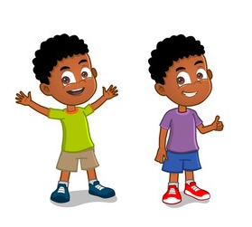
13
I did it! I pooped or peed in the toilet!

Slide 13
14
When I am done, I will wipe my bottom, pull up my pants, and flush the toilet.

Slide 14
14
Then I will wash and dry my hands.
I can scrub using soap and water.

Slide 15
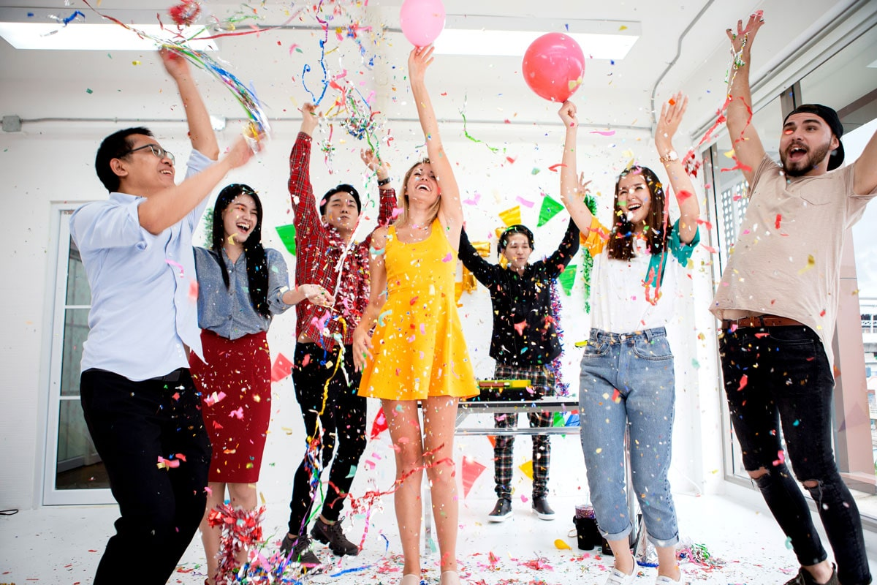
15
I am all done and can go back to play now. I am so proud of myself for using the toilet and my friends, family, and teachers will be proud too!

Slide 16
Picture resources:
1. https://www.dreamstime.com/illustration/little-boy-cartoon-sitting-toilet.html
2. https://wallpapersafari.com/w/VGgvID
3. https://medium.com/mel-magazine/what-happens-to-a-poop-when-you-hold-it-in-until-it-goes-away-820e4edcca97
4. https://www.amazon.com/Boboking-Cotton-Dinosaur-Toddler-Underwear/dp/B089M57PSQ
5. https://www.amazon.com/Closecret-Underwear-Toddler-Panties-Assorted/dp/B07CST2NTW
https://www.isitbadforyou.com/questions/is-holding-your-pee-bad-for-you
https://www.vectorstock.com/royalty-free-vector/cartoon-children-wake-up-vector-5610664
https://www.vectorstock.com/royalty-free-vector/little-girl-sitting-on-toilet-vector-5584530
https://pngtree.com/freepng/sleeping-child_2733533.html
https://www.vectorstock.com/royalty-free-vector/boy-getting-out-green-car-vector-8643289
https://www.instagram.com/p/Bp8GTFenAWb/?epik=dj0yJnU9ZE9WbVdORExtYVdmWURjcVVFV29HOV8zNnpVX2dZSTAmcD0wJm49WUVwMTl5aDI1dlgtVkVNTjJ5T1ZXZyZ0PUFBQUFBR0JQZEtJ
https://wdrfree.com/stock-vector/download/vector-illustration-of-a-kid-at-toilet-132338642
https://www.shutterstock.com/image-vector/african-american-boy-708935980
https://i.pinimg.com/originals/1e/ad/3f/1ead3ff71b6d3f0eae9307cf7cb61c83.jpg
https://www.hoppier.com/blog/work-anniversary

